Slide 1
Nucleic Acids & Chromosomes
Lecture 17

Slide 2
Objectives
Define nucleotide, nitrogenous bases
Describe structure of a nucleotide and list the types of nitrogen bases
Compare between DNA & RNA and describe briefly their structure & functions
List the types of RNA and know function of each type
Understand Chargaff's rule
Describe double helix of DNA
Understand terms minor groove, major groove, B DNA, Z DNA
Describe the term genome
Describe briefly the structure and replication of chromosomes
Define the terms nucleosome, solenoid, centromere, replication bubble, RNA primer

Slide 3
Nucleic Acids
Nucleic acids form the structure of genes, which provide the basic blueprint of life
They are the largest molecules in the body, being polymeric forms. There are two different types of nucleic acids
Deoxyribonucleic acid (DNA)
Ribonucleic acid (RNA)
Genes are sequences of DNA that code for proteins or RNA
All gene action determines the development of the cell and ultimately of the entire organism (if multicellular)
Genes thus determine the type of organism: species
Nucleic acids consist of atoms of carbon (C), oxygen (O), hydrogen (H), nitrogen (N) and phosphorus (P)

Slide 4
Nucleotides
Nucleotides are the monomeric building blocks of nucleic acids: nucleic acids are thus polynucleotides (polymeric nucleotides)
Each nucleotide has three identifiable moieties (parts)
Two types of nitrogen-containing bases
purines: these are 2-aromatic ringed structures
pyrimidines: these are 1-aromatic ringed structures
ketopentose sugar
2'-deoxyribose in DNA
ribose in RNA
phosphate
When DNA and RNA are in solution, the presence of negatively charged phosphate in the DNA and RNA structure makes DNA and RNA very highly negatively charged polymers, and this has tremendous biological significance in their biochemistry

Slide 5
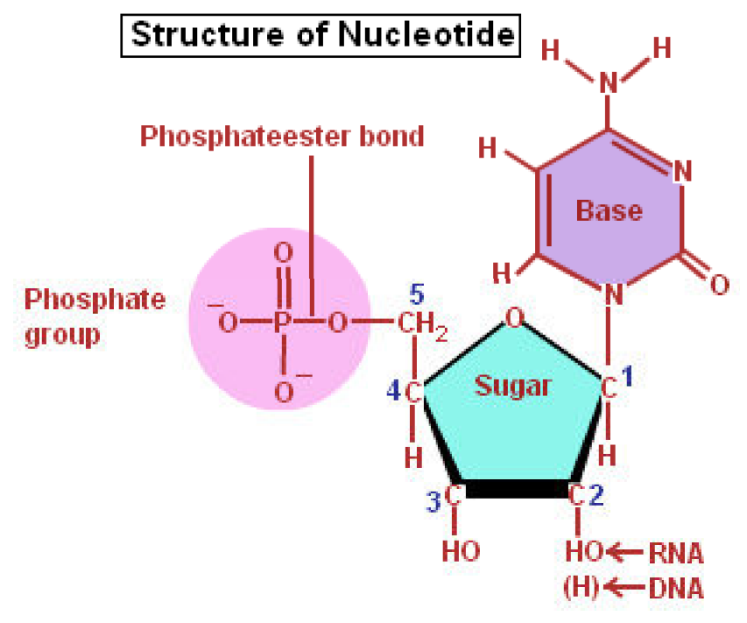
Nucleotide Structure

Slide 6
Nitrogenous Base Features
Within the nucleotide, some detail of the purine and pyrimidine nitrogenous bases
The 2-ringed purines are in both DNA and RNA
adenine (symbolized A)
guanine (symbolized G)
The 1-ringed pyrimidines are
cytosine (symbolized C) is common to DNA & RNA
thymine (symbolized T) is found only in DNA
uracil (symbolized U) is found only in RNA
When RNA is transcribed (made from template of) DNA, U represents the place of T
Mnemonics to assist learning
purine: Pure As Gold, pyrimidine= CUT

Slide 7
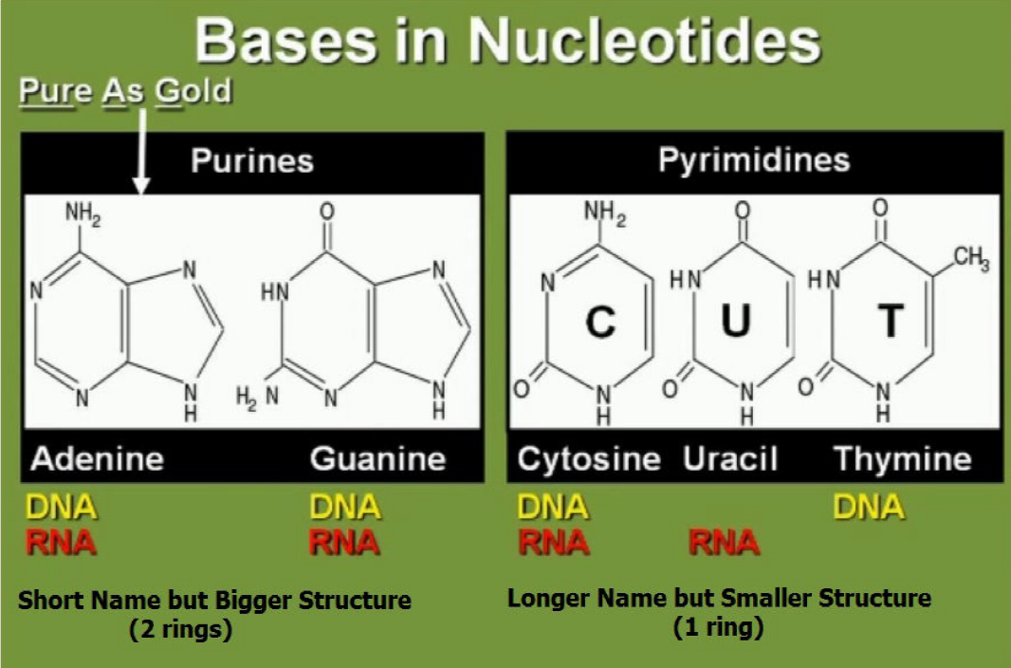
Nitrogenous Bases

Slide 8
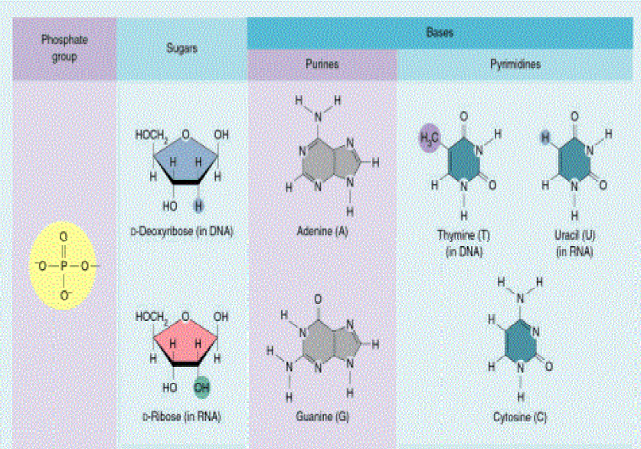
Nucleotide Structure

Slide 9
DNA Structure
Deoxyribonucleic acid (DNA) is found within nucleus consisting of a spirally winding, double-stranded chain (helix) of polymeric nucleotides (polynucleotides)
Two polynucleotide chains held together by hydrogen bonds formed between the bases
A copolymeric chain of deoxyribose sugar & phosphate molecules form "backbone" of the "ladderlike" DNA structure
The H-bonded pairing of the bases form the "rungs" of the ladder
The H-bond pairing of bases is very specific
Purine adenine (A) always pairs with pyrimidine thymine (T), forming TWO hydrogen bonds in the pairing
Purine guanine (G) always pairs with pyrimidine cytosine (C), forming THREE hydrogen bonds in the pairing

Slide 10
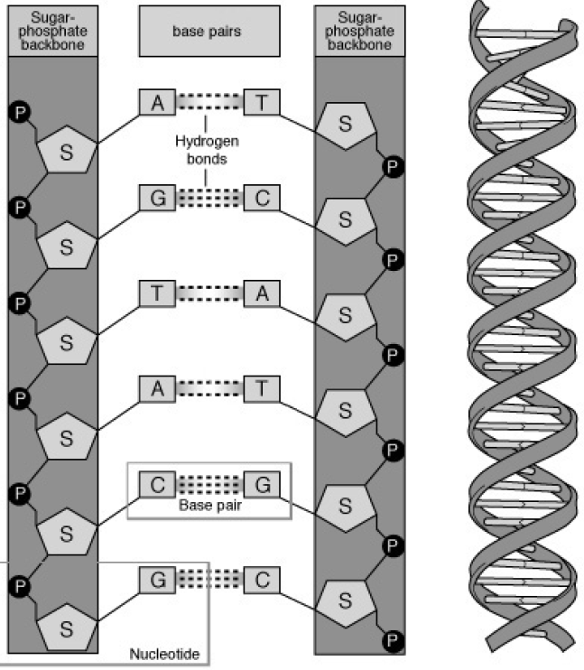
DNA Structure
The Ladder & The Double Helix
Hydrogen bonding
2 H-bonds T=A
3 H-bonds G≡C

Slide 11
DNA Function
Machinery to Replicate with Integrity Polymerase enzymes are huge protein complexes that ensure that the polynucleotide sequence of DNA replicates (copies) itself exactly, preparing the complimentary copy strand from a template strand, so all new cells have the information
Codes for all Cell Structure & Function DNA contains the codes producing all proteins and RNA in genes
Regulates Expression of Its Genes DNA also contains codes which are regulatory sequences that direct when genes are expressed, and how much the products of genes are to be expressed

Slide 12
Chargaff's Rule
Watson & Crick (1953) use Franklin's x-ray diffraction to deduce the double-stranded helix and propose explanation for how DNA replicates
Chargaff's rule: Number of purines in DNA is equal to the number of pyrimidines
%A = %T and %G = %C
Q: if DNA content has %G=10%, what is %T?
A: if %G =10%, %G=%C, so %C =10%; thus A+T is 80%, and since A=T so %T=40%
Watson & Crick structure showed purines & pyrimidines face the center of the helix, forming "steps" in a "spiral staircase," and they were H-bonded to each other

Slide 13
RNA Structure / Composition
Ribonucleic acid (RNA) is a single-stranded polynucleotide chain that is transcribed from DNA
Structure similarity with DNA
the nitrogenous bases A, G & C are common to DNA
phosphate is part of the backbone
Structure difference with DNA
the nitrogenous base uracil (U) is used in RNA & is the substitute for thymine (T) in DNA
the pentose sugar is ribose in RNA and not 2'-deoxyribose in DNA
while DNA always remain in the nucleus, RNA in all its forms is exported from the nucleus to perform its function

Slide 14
RNA Main Types & Functions
Three types of RNA, all of which are transcribed from DNA in the nucleus, processed, then exported from nucleus
Messenger RNA (mRNA)
contains the protein-coding type of gene, and is translated to form a polypeptide that is or becomes part of the complete functional protein
Ribosomal RNA (rRNA)
Ribosomes are made of two or three long RNA strands and a couple of dozen proteins: rRNA is the RNA used to make ribosomes, and is heavily involved in protein synthesis
Transfer RNA (tRNA)
A cloverleaf-like short-length RNA that bonds with the amino acids that will become part of polypeptides during protein synthesis

Slide 15
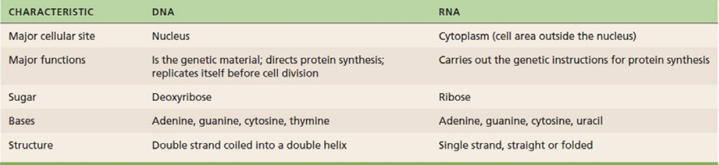
Comparison of DNA & RNA

Slide 16
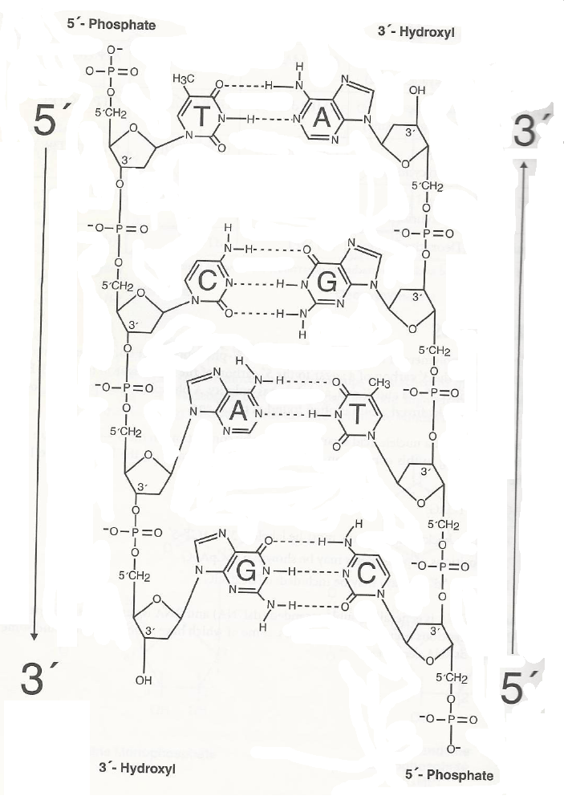
Hydrogen – Bonded Base Pairs in DNA
summary

Slide 17
Double Helix Features
The helical formation of the two strands is such that they form a major groove and minor groove
Proteins having various functions to regulate the reading, synthesis, and repair of DNA depend on differences in this groove formation
The phosphate bonding of the pentose sugar (deoxyribose) is on hydroxyl functions of the 3' and 5' carbons of the sugar, and DNA shows a polarity in this regard
The two strands that bond to form the double helix do so in antiparallel fashion: one strand has a directionality of 5'→3', and the H-bonding to the other strand is such that its 5'→3' directionality proceeds in the opposite direction (an antiparallel directionality)
This antiparallel directionality in the strands has tremendous biological significance in the synthesis and utilization of DNA

Slide 18
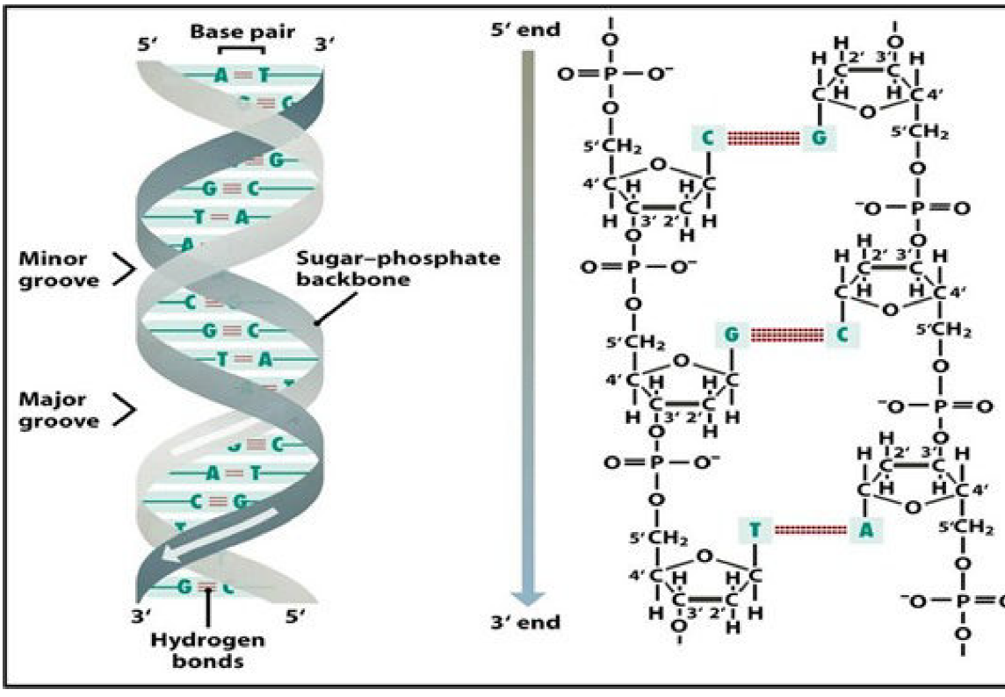
The 5-prime (5') and 3-prime (3') ends of DNA refer to the carbons on the deoxyribose sugar on the backbone, where the phosphate group connects in the polynucleotide
This polarity has biological significance in the formation and maintenance of DNA

Slide 19
Types of DNA
Watson & Crick originally suggested that all DNA follows a right-handed twisting helix
25 years later (1979) scientists discovered DNA a lefthanded twisting DNA occurring in DNA segments (not the whole of the DNA)
The classical conformation of DNA is called B-DNA, with its major and minor grooves
The left-handed twist of DNA shows a sugar-phosphate backbone with zig-zag pattern: this is called Z-DNA
The ability to read (transcribe into RNA) Z-DNA is significantly reduced, so this may be a form of regulating what DNA is readable

Slide 20
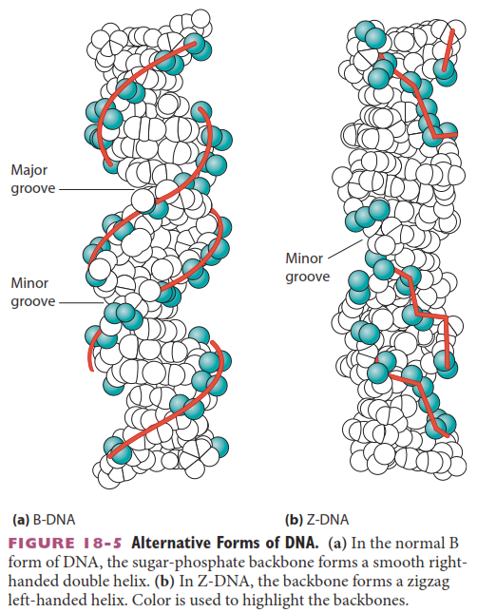
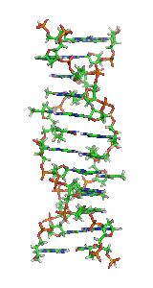
Comparing B-DNA (classical right-hand twisting helix) to Z-DNA (zig-zag left-hand twist)

Slide 21
DNA Denaturation
The hydrogen bonding between bases of the DNA strands holds them in the double helix
We know that H-bonding is a weaker form of chemical bonding: it holds H₂O molecules together to form liquids (water), but with temperature increases, these bonds can be broken
Indeed, if DNA is present in near-boiling water, the H-bonds are broken and two separated single strands form with the double helix broken: this is called denaturation

Slide 22
T_{m}: Melting Temperature
Scientists use reversible heat-denaturation of DNA to determine base composition of DNA and for other experiments with DNA
The temperature at which a segment of DNA "melts" (denatures) is a function of the number of GC and AT pairs and is called the melting temperature (symbolized T_{m})
GC pairs are held together by 3 H-bonds, and AT by 2-H-bonds: thus a DNA segment with a higher %GC will be expected to melt at a higher temperature, since it takes more energy to denature it
The absorption of DNA at 260 nm (UV) light increases when it goes from double-stranded to single-stranded: thus it is possible to follow a 260 nm vs. temperature plot for different DNA segments and see different T_{m} values for each
DNA can renature its two strands as the temperature of the solution falls: in many cases, it renatures fully when DNA segments are short, but with long segments, the renaturation is not to original state and can involve mispairing

Slide 23
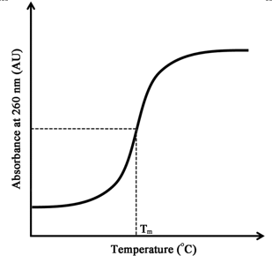
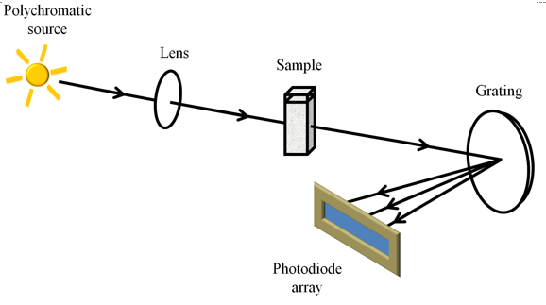
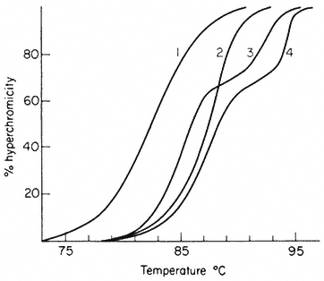
The figure above shows the principle of how a UV or visible light spectrophotometer works for looking at the optical properties of molecules, such as detecting the difference between DNA that is denatured or not
Denatured or single-stranded DNA absorbs at 260 nm more than double stranded DNA, as shown in the plot at top left. The midpoint of the transition or change in absorption of 260 nm from ss DNA to ds DNA is called the "melting temperature" or Tm
At left, you can see different sequences of DNA with different base compositions (%GC/%AT) with different melting temperatures (%hyperchromicity is just another way of looking at "absorption at 260 nm") Can you tell which have the higher %GC content??

Slide 24
Breaking the Double Helix
The H-bonds of the DNA double helix must be broken and the strands separated to perform natural processes such as the synthesis of DNA during its replication or repair, or for the reading of the code by polymerases making RNA during transcription
The proteins that work on DNA are enzymes, and enzymes allow nature to get around the process of having to raise the temperature of the cell to boiling by lowering the activation energy of a chemical process or reaction
Thus the proteins do not need to increase temperature to break hydrogen bonds, but rather lower the energy required to do so

Slide 25
Genomes
Genome = one complete copy of the genetic information of an organism (and in eukaryotes, of certain organelles)
The genome of eukaryotic (human) cells is contained within the nucleus of the cell
Mitochondria also have their own genome, although it only supplies genes for parts of its function (it is thus a limited genome)
Eukaryotic genomes are organized on chromosomes
In humans, there are 23 homologous pairs of chromosomes, a set of 23 chromosomes inherited from the male and female of a sexually reproducing species

Slide 26
Genome Size
The size of a genome is given as count of nucleotide pairs per haploid genome
Genomes for bacteria and some viruses are usually contained in a single circular DNA molecule
some viruses show linear segments of DNA
Genome size typically increases with complexity of the organism (with but few exceptions)
Viruses have enough genomic DNA to code for a few proteins, often those that determine the body of the virus and those that hijack the systems of the cell to copy the virus genome and express its proteins
Human DNA
3.2 billion (3.2 × 10⁹) base pairs (bp, nucleotide pairs)
codes for an estimated 21,000 proteins
only ~2% of the genome consist of coding sequence (genes)

Slide 27
Chromosomes, Chromatids
In eukaryotes, chromosomes are linear segments of DNA and associated proteins that hold part of an organism's genome, and are located in the nucleus
Chromosomes appear microscopically and typically at metaphase and with staining as compact X-shaped bodies within the nucleus
The arms along a long axis of the chromosome represent chromatin: single long DNA polynucleotide + RNA + protein
The long & short arm represent a chromatid
In most cases, the DNA of the chromosome is duplicated as an exact copy, and the DNA copies are joined at a centromere
Because they are exact copies, the chromatids joined at the centromere are called sister chromatids
The creation of an exact copy (a sister chromatid) is important when the cell is to divide into daughter cells

Slide 28
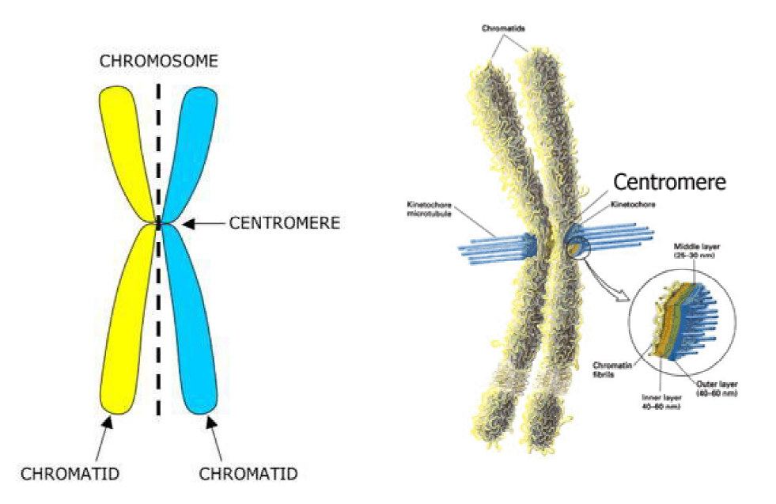
Chromosome Structure

Slide 29
Nucleosomes
Chromosome formation starts with a fundamental coiling of DNA called the nucleosome
Nucleosomes are composed of proteins called histones which form a complex in which the DNA wraps about two times around the complex
There are five different histone proteins named H1, H2A, H2B, H3 and H4
An octameric core of histones forms a complex first: this core is two copies each of four histones H2A, H2B, H3, H4
Histone H1 is not part of the nucleosome core, but acts as a linking spacer between nucleosomes
The interaction between histones and DNA is all about electric charge: histones have many positively charged amino acids (arginine, lysine side chains) which interact with the negatively charged phosphate groups on DNA

Slide 30
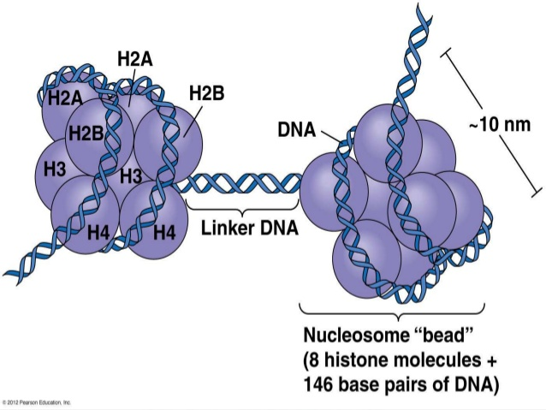
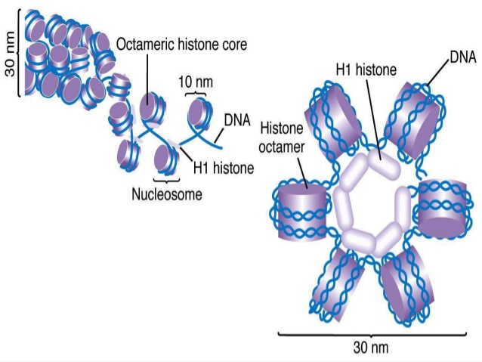
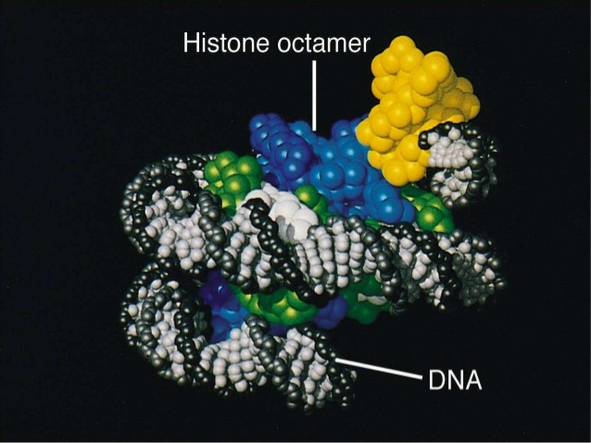
A look at the histone core schematically and with a space-filling model: note how DNA loops about the core about twice (146 nucleotides)
Above, the histones are packed into solenoids

Slide 31
Chromosome Packing Organization
chromatin fibers: nucleosomes create a long chain called a chromatin fiber about 10 nm thick
each chromatin fiber forms a helical coil called a solenoid, 30 nm thick; each coil of the solenoid has about 6 nucleosomes per coil
in turn, a solenoid coils to form a hollow tube about 200-300 nm thick in the interphase chromosome
with onset of mitosis, further thickening occurs to form 600-700nm thick chromatids
a chromosome consists of two chromatids attached by a centromere: the two chromatids of a chromosome will separate during mitosis

Slide 32
Packing Calculations
The extent of this coiling & compaction of DNA is described quantitatively as the packing ratio
packing ratio = length of linear DNA molecule divided by length of the coiled structure
Nucleosome formation makes a 7:1 packing ratio
Solenoid formation reduces length by 6, so with a solenoid present, packing ratio = 42:1
Formation of 6 solenoid/turn hollow tubes shortens another 18 times, so packing ratio = 750:1
When cell division begins in mitosis, the chromosome has a packing ratio = 15,000-20,000:1

Slide 33
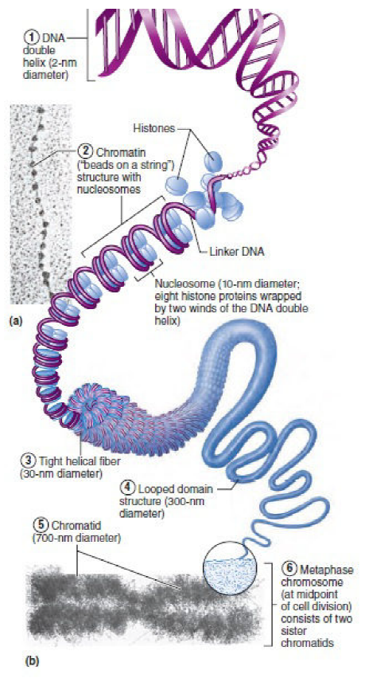
Chromosomes:
Chromatin and Chromosome Structure
(a) Electron micrograph of chromatin fiber
Magnification: 125,000X
(b) DNA packed in a chromosome. The levels of increasing structural complexity (coiling) from the DNA helix to the metaphase chromosome are indicated in order from the smallest ( “1” DNA double helix) to the largest and most complex ( “6“ chromosome)

Slide 34
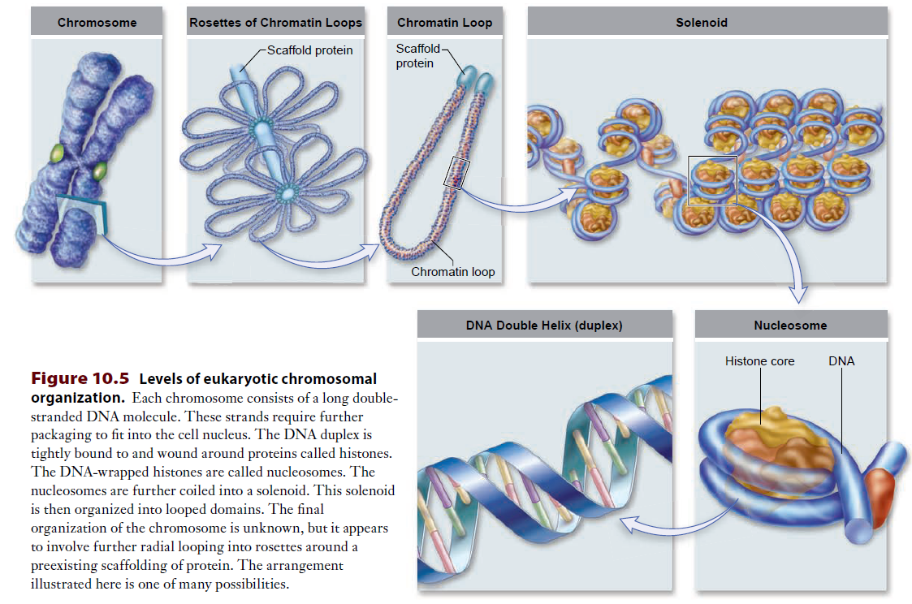

Slide 35
Replication of DNA / Chromosome 1 of 3
S (synthesis) phase: all genomic DNA in all chromosomes has replicated (duplicated)
DNA replication involves partial denaturation of several sites along chromosome: each start site is called an origin of replication
DNA polymerase enzymes utilize high energy nucleotides (dATP, dGTP, dCTP, dTTP) and pair them to each of the two existing, partially separated template strands to make a new strand complementary to the template
DNA polymerases are unable to initiate a new strand however: they must be primed by the presence of a short RNA fragment first synthesized on the open strands; this short RNA fragment synthesis is achieved by enzymes called RNA primases

Slide 36
Replication of DNA / Chromosome 2 of 3
DNA polymerases synthesize new DNA in the 5'→3' direction
This means for one of the open strands, synthesis is continuous and need not be interrupted (leading strands)
But for the other strand, DNA must be synthesized discontinuously because of the requirement for synthesizing in the 5'→3' direction: thus multiple RNA primers are constructed to enable DNA synthesis for a short stretch (lagging strand)
Note that bases added to the new strands must pair: where there is a T, an A base is added to the new strand; where there is a G, a C base is added to the new strand

Slide 37
Replication of DNA / Chromosome 3 of 3
Two types of DNA polymerase actually do all the DNA synthesis
DNA polymerase III works off the RNA primer and synthesizes as much DNA as it can on the continuous (leading) strand; on the discontinuous (lagging) strand, it stops at the RNA primer ahead of it (it cannot run through it)
DNA polymerase I is about to fill in all the gaps and run right through RNA primers, replacing them with DNA nucleotides; it is thought of as an editing enzyme
DNA ligase is a special enzyme that joins any sugar-phosphate bond breaks, which can remain from the synthesis operation

Slide 38
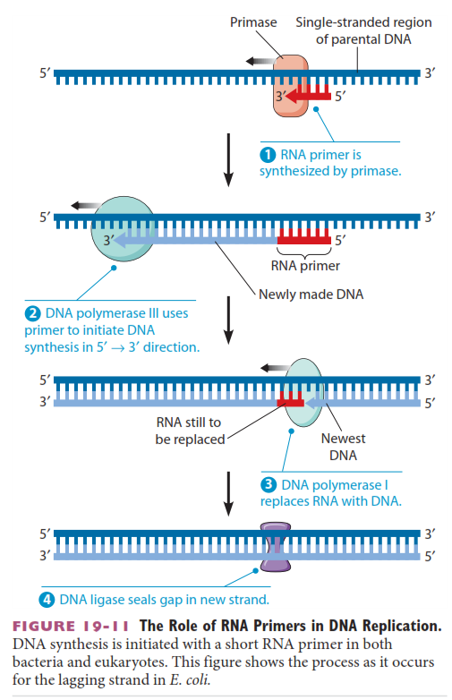
Form the RNA primer with the RNA primase enzyme
Extend with making DNA using the DNA polymerase III enzyme
DNA polymerase I fills in gaps and runs ("eats") through the RNA primers
DNA ligase fills in sugar-phosphate bond break gaps

Slide 39
Replication Forks, Bubbles, etc
Replication Bubble: The opening of double-stranded DNA to two single strands has the appearance of a "bubble" under electron microscopes. Each bubble has two Y-shaped replication forks which are the points where the double strand helix are separated to achieve semiconservative synthesis of two new strands on templates
Each eukaryotic chromosome has hundreds of initiation points (origins of replication), forming bubbles. Adjacent bubbles fuse to generate larger bubbles: the two new double strands being separated
Semiconservative replication refers to the fact that the two new "daughter" strands are the other strand of the parent strand

Slide 40
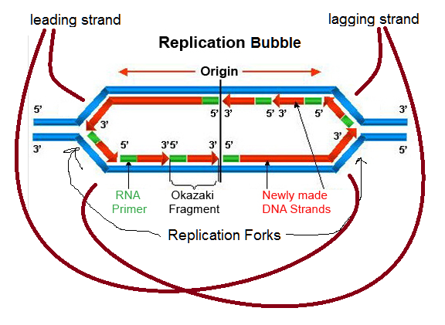
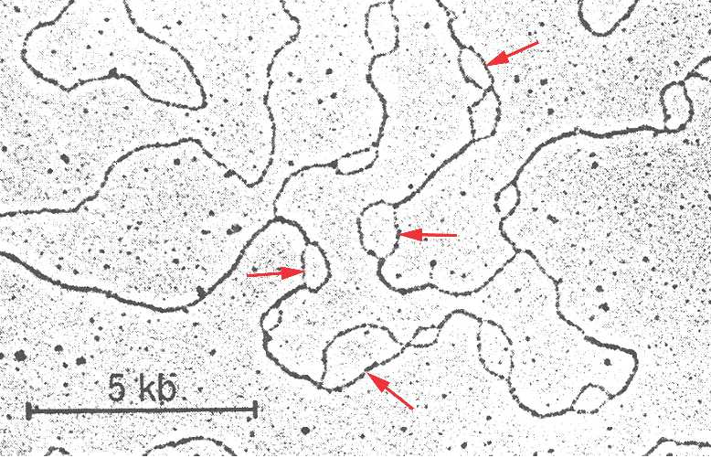
The terms used to refer to the features of DNA replication
The "leading strand" refers to continuous DNA synthesis in the 5'→3' direction, while the "lagging strand" refers to the need for interrupted or discontinuous synthesis to complete its strand
Replication bubbles as seen with EM at lower left

Slide 41
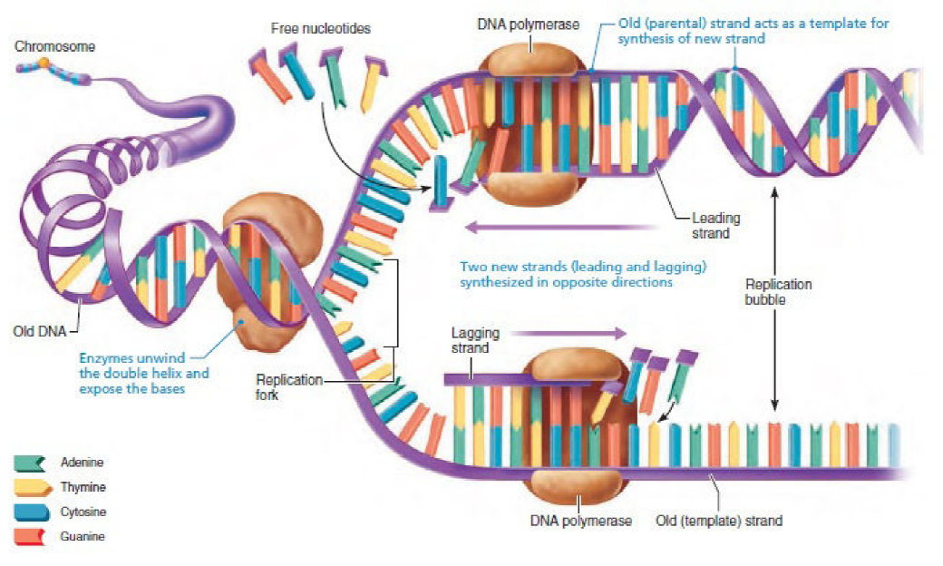
Replication of DNA Summary: Once the DNA helix is uncoiled, and the hydrogen bonds between its base pairs are broken, each nucleotide strand of the DNA acts as a template for constructing a complementary strand, as illustrated on the right-hand side of the diagram. (The step in which RNA primers are formed to start the process at replication bubbles is not shown.)
DNA polymerases work in one direction only, so the two new strands (leading and lagging) are synthesized in opposite directions. (The DNA ligase enzymes that join the DNA fragments on the lagging strand are not illustrated.) Each DNA molecule formed consists of one old (template) strand and one newly assembled strand and constitutes a chromatid of a chromosome.

Slide 42
Reading (Sources)
Becker's WotC: pp 510-514, 515-518, 530-533, 553-559, 561-563
Raven: Chap 14.3, 14.5, 15.1, 15.2, 16.5

